Slide 1
Visual Basic .NET Exercises
part II
Wiktor Tracz Faculty of Forestry, Warsaw University of Life Sciences, Poland

Slide 2
Laboratory 1
Using ComboBox, ListBox, RadioButton, CheckBox, GroupBox controls and InputBox function

Slide 3
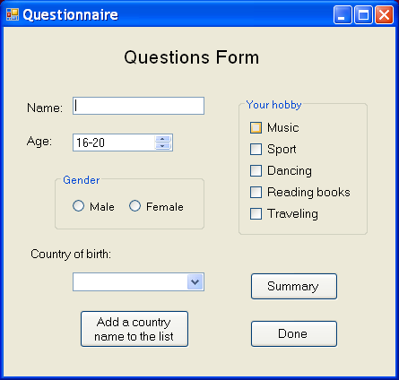
Exercise 1: Design user interface

Slide 4
Exercise 2: Set properties of controls
Controls’ name
ComboBox | cboCountry
GroupBox | grbHobby
CheckBox | chkMusic
GroupBox | chkSport
GroupBox | chkDancing
GroupBox | chkBooks
GroupBox | chkTraveling
Button | btnSummary
Button | btnDone
Label Title | lblTitle
Label Name | lblName
Label Age | lblAge
Label Country | lblCountry
TextBox Name | txbName
ListBox | lstAge
GroupBox | grbGender
RadioButton | rdbMale
RadioButton | rdbFemale
Button | btnAdditem

Slide 5
Exercise 3: Type the code
Take the name of the user from text box
Take selected item in list box
Determine what gender was pointed
Determine what hobby was checked
Add the name of new country to the combo box (use the InputBox function)
Take the name of the country that was selected
Show message box presented all collected information
Sort items in the combo box

Slide 6
Laboratory 2
OpenFileDialog, SaveFileDialog, FolderBrowserDialog, FontDialog, Timer controls exercises

Slide 7
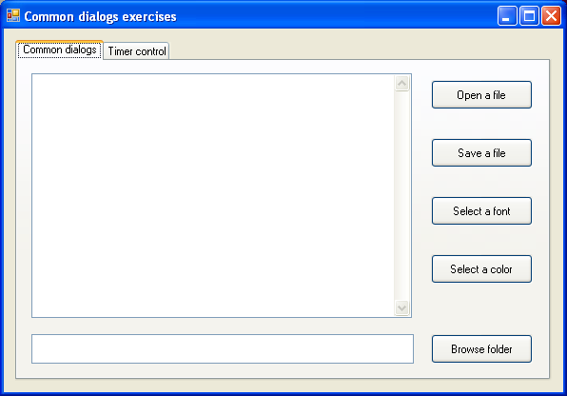
Exercise 1: Design user interface

Slide 8
Exercise 2: Set properties of controls
Textbox (name: txtFileViewer)
- Multiline = True
- ScrollBar = Vertical
Textbox (name: txtDirectoryName)
- Multiline property = True
Tab control has 2 tabs assigned to the TabPages property with “Common dialogs” and “Timer control” values of Text property.
Use the following construction to see how the dialog box was closed:
If myOpenFileDialog.ShowDialog = Windows.Forms.DialogResult.OK Then
txtFileViewer.Text =_ My.Computer.FileSystem.ReadAllText(myOpenFileDialog.FileName)
End If

Slide 9
Exercise 3a: Type the code
When click on ”Open the file” button the file must be opened in the txtFileViewer textbox. Use the OpenFileDialog control to allow user choosing the file. Set several different properties of the OpenFileDialog control.
Use the SaveFileDialog control to select the file to which text from the txtFileViewer textbox will be written when the ”Save a file” button is clicked. Set several different properties of the SaveFileDialog control.
Use the FontDialog control to allow user to select a font (when ”Select a font” button is clicked) and set it for text in the txtFileViewer textbox. Set several different properties of the FontDialog control.

Slide 10
Exercise 3b: Type the code
Use the ColorDialog control to allow user to select a color (when ”Select a color” button is clicked) and set it for text in the txtFileViewer textbox. Use several different properties of the ColorDialog control.
When click ”Browse folder” button the path to the folder chosen by user must be presented in the txtDirectoryName textbox. Use the FolderBrowserDialog control to allow user choosing the folder. Set several different properties of the FolderBrowserDialog control.

Slide 11
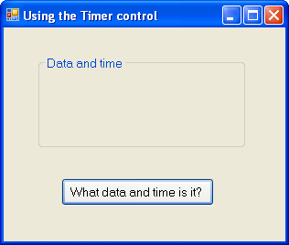
Exercise 4: Design user interface for using the Timer control

Slide 12
Exercise 5: Type the code to use the Timer control
When click “What data and time is it?” button the current data and time (with interval of 1 second ) must be presented as the lable placed in the “Data and time” group box. Text on the button is changed to ”Stop”.
When click ”Stop” button presentation of data and time must stop, and text on the button is changed to ”Start”.
When click ”Start” button the current data and time (with interval of 1 second ) must be presented again, and text on the button is changed to ”Stop”.

Slide 13
Laboratory 3
Manipulating files and directories

Slide 14
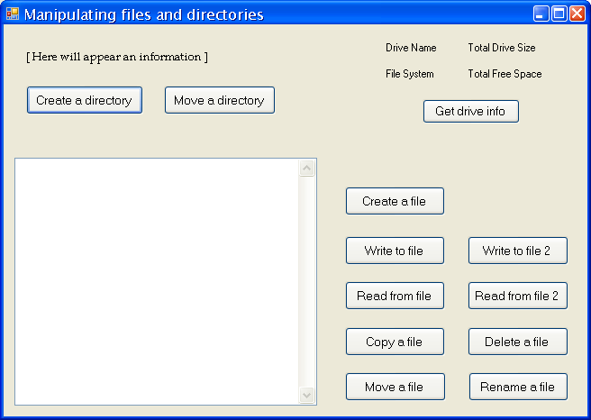
Exercise 1: Design user interface

Slide 15
Exercise 2: Set properties of controls
Textbox (name: txtFileViewer)
- Multiline = True
- ScrollBar = Vertical

Slide 16
Exercise 3a: Type the code
When click “Get drive info” button information on drive name, file system, total drive size and free space will appear as labels above the “Get drive info” button.
When click “Create a directory” button a directory in specified location will be created.
When click “Move a directory” button a directory will be moved to specified location.
When click “Create a file” button a file with specified name and location will be created.

Slide 17
Exercise 3b: Type the code
When click “Write to file” button lines of text will be written to text file, which are
This is the header for the file.
--------------------------------------
The date is: < current date and time >
When click “Read from file” button the content of specified text file will be read and presented in the textbox.
When click “Copy a file” button the specified file will be copied to other location.
When click “Move a file” button the specified file will be moved to new location.
When click “Delete a file” button the specified file will be deleted.

Slide 18
Laboratory 4
Error handling

Slide 19
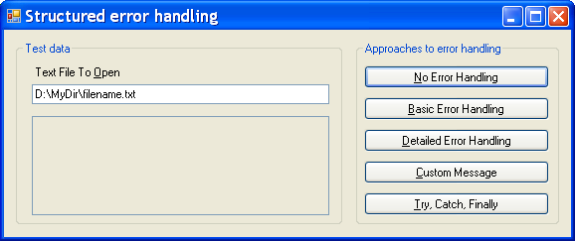
Exercise 1: Design user interface

Slide 20
Exercise 2: Basic error handling
Create click event procedure for the “Basic Error Handling” button. In the procedure open the file (use the FileStream class) which name is typed in Text File To Open line.
If the file exists a message box will appear and present the size of the file.
If the file doesn’t exist use Exception class to trap an error. Present description about the error using message box.
Use Try Catch structure do perform exercise.

Slide 21
Exercise 3: Detailed error handling
Create click event procedure for the “Detailed Error Handling” button. In the procedure open the file (use the FileStream class) which name is typed in Text File To Open line.
If the file exists a message box will appear and present the size of the file.
If the file doesn’t exist use FileNotFoundException, DirectoryNotFoundException, IOException and Exception classes to trap an error precisely. Present description about the error using message box.
Use Try Catch structure to perform exercise.

Slide 22
Exercise 4: Try Catch Finally structure
Create click event procedure for the “Try, Catch, Finally” button. In the procedure open the file (use the FileStream class) which name is typed in Text File To Open line.
If the file exists a message box will appear and present the size of the file.
If the file doesn’t exist use Exception class to trap an error. Present description about the error using message box.
In Finally part of the structure check whether the file was opened successfully and if so close the file and present message about that.
Use Try Catch Finally structure to perform exercise.

Slide 23
Laboratory 5
Menus and toolbars controls

Slide 24
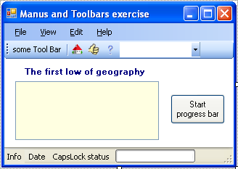
Exercise 1: Design user interface
add MenuStrip, StatusStrip, ContextMenuStrip, ToolStrip, FontDialog, ColorDialog, Label, TextBox and Button controls to the form.
Menu items
ComboBox
Buttons
Labels
Progress bar

Slide 25
Exercise 1a: Set properties of controls
Progress bar
Minimum: 0
Maximum: 100 000
Step: 5
Size: 110; 18
Text box
Multiline: True
Form
KeyPreview: True

Slide 26
Exercise 2: Type the code
CapsLock key status: present text ”CAP” on the status bar when key Caps Lock is pressed.
Use:
- KeyDown event for Form object, which occurs when a key is pressed while the control has focus.,
- My.Computer.Keyboard.CapsLock property (boolean data type) to cheack status of CapsLock buton.
Start progress bar when ”Start progress bar” button is pressed.

Slide 27
Exercise 3: Type the code
Open file: present the context of the flog.txt file in the textbox when command Open is selected from menu File. Use the following code:
If File.Exists(FILE_NAME) Then
txtFileOpen.Text = File.ReadAllText(FILE_NAME)
Else
MsgBox("File does not exist", MsgBoxStyle.Exclamation)
End If

Slide 28
Exercise 4: Type the code
Font and color change: allow user to change font of the text in the textbox and background color of the textbox by mean of context menu.
Use FontDialog and ColorDialog controls.
If myFontDialog.ShowDialog = Windows.Forms.DialogResult.OK Then
…some…code…
End If
Present pictures/icon on buttons on the tool bar. Use files: house.gif, question_mark.gif, ok.gif.
Use Image and DisplayStyle properties of the buttons.

Slide 29
Exercise 5: Type the code
Presentation information about an element of user interface: when mouse pointer enters on some of menu items the name of menu command is presented on the status bar. When mouse pointer leaves an menu item – no information is presented.
Use events
MouseEnter for ToolStripMenuItem – occurs when the mouse pointer enters the control
MouseLeave for ToolStripMenuItem – occurs when the mouse pointer leaves the control

Slide 30
Laboratory 6
Accessing data stored in database

Slide 31
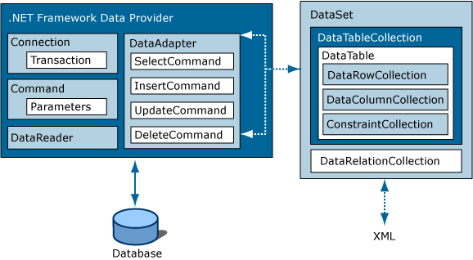
ADO.NET architecture

Slide 32
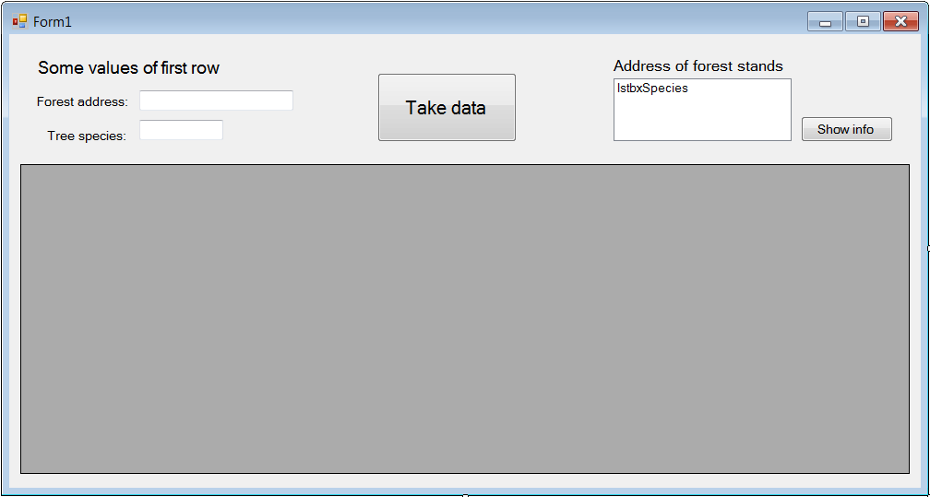
Exercise 1: Design user interface

Slide 33
Exercise 2: Set properties of controls
Take data button – name: btnTakeData
Shaw info button – name: btnShow
DataGridView – name: myDataGridView
List box – name: lstbxSpecies
Forest address textbox – name: txtADRES_FOR
Tree species textbox – name: txtTREE_SPECI

Slide 34
Exercise 3: Type the code
1. When application is loaded, fill out listbox with values of forest addresses, which are stored in forest_stands table of fstands database. Prepare code for connection to Access and SQL Server database.
2. When a forest stand addresses is selected in listbox, show all values for this forest stand stored in forest_stands table of fstands database.
3. When “Take data” button is clicked, display values from 2-nd and 3-rd columns of 1-st row of forest_stands table in textboxes.

Slide 35
Laboratory 7
Project deployment

Slide 36
Exercise 1: Open ”Timer” application

Slide 37
Exercise 2: Setting the project deployment properties
Open the Publish pane of the Project Designer and set following deploying options:
- Publishing locations
- Install mode
- Publish options
- Update requirements
- Prerequisites
- Application files

Slide 38
Exercise 3: Project publishing and installation
Publish the project with set properties
Install the program. See what happens:
- what is the installation folder of installed program;
- what is the way the program can be launched;
- can you uninstall the program, how;

